Slide 1

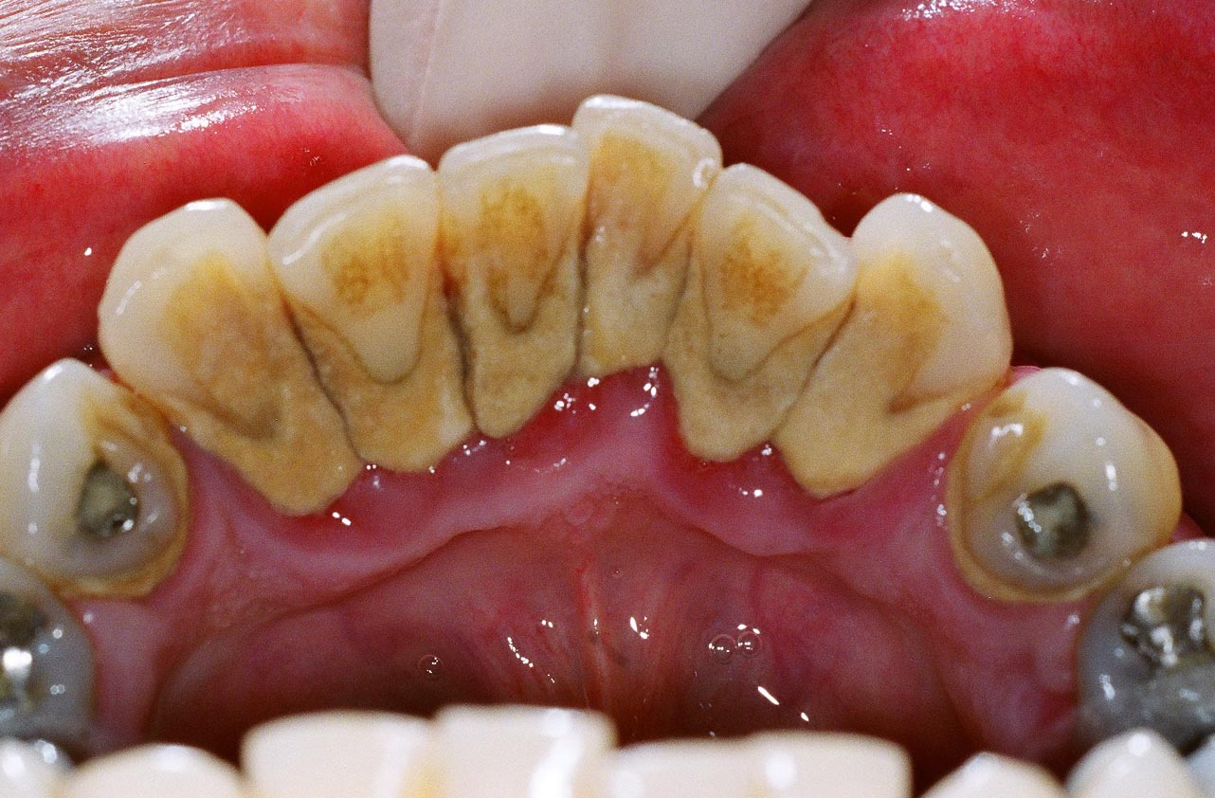
RUNGTA COLLEGE OF DENTAL SCIENCES AND RESEARCH,BHILAI
DENTAL CALCULUS
Dr PushpendraYadav
Sr. lecturer
Dept of Periodontology

Slide 2
SPECIFIC LEARNING OBJECTIVES
CORE AREAS | DOMAIN | CATEGORY
INTRODUCTION | Affective | Desire to know
DEFINITION | Cognitive | Must to know
CLASSIFICATION | Cognitive | Must to know
COMPOSITION | Cognitive | Must to know
FORMATION | Cognitive | Must to know
THEORIES | Cognitive | Must to know
ETIOLOGIC SIGNIFICANCE | Cognitive | Must to know
MATERIA ALBA, FOOD DEBRIS, AND DENTAL STAINS | Cognitive | Must to know
Other predisposing factors | Cognitive | Must to know
FOOD IMPACTION | Cognitive | Must to know
MATERIALS | Cognitive | Must to know
PARAFUNCTIONAL HABIT | Cognitive | Must to know

Slide 3
CONTENT
PART I
INTRODUCTION
DEFINITION
CLASSIFICATION
COMPOSITION
FORMATION
PART II
THEORIES
ETIOLOGIC SIGNIFICANCE
MATERIA ALBA, FOOD DEBRIS, AND DENTAL STAINS
OTHER PREDISPOSING FACTORS
FOOD IMPACTION
MATERIALS
PARAFUNCTIONAL HABIT
SUMMARY
REFERENCE

Slide 4
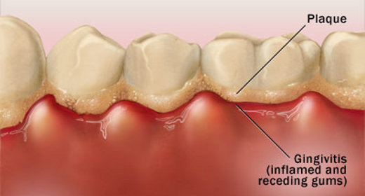
INTRODUCTION
The primary cause of gingival inflammation is bacterial plaque.

Slide 5
other predisposing factors include
  calculus,
  malocclusion,
  faulty restorations,
  complications associated with orthodontic therapy,
  self–inflicted injuries,
  use of tobacco, and
  radiation therapy.

Slide 6
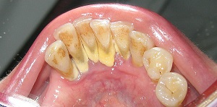
DEFINITION
Calculus consists of mineralized bacterial plaque that forms on the surfaces of natural teeth and dental prostheses.
Also known as Tartar

Slide 7
CLASSIFICATION
According to location
a) Supragingival calculus
b) Subgingival calculus
According to source of mineralization
a) Salivary calculus
b) Serumal calculus
According to surface
a) Exogeneous
b) Endogeneous

Slide 8
SUPRAGINGIVAL CALCULUS
LOCATION: coronal to the gingival margin and therefore is visible in the oral cavity.
COLOR: It is usually white or whitish yellow in color,
CONSISTENCY: hard with claylike consistency, and easily detached from the tooth surface.

Slide 9
The color is influenced by contact with such substances as tobacco and food pigments.
It may localize on a single tooth or group of teeth, or it may be generalized throughout the mouth.

Slide 10
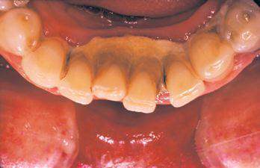
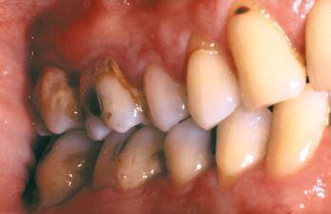
The two most common locations:
the buccal surfaces of the maxillary molars and
the lingual surfaces of the mandibular anterior teeth

Slide 11
Saliva from the parotid gland flows over the facial surfaces of upper molars through Stensen’s duct, whereas the orifices of Wharton’s duct and Bartholin’s duct empty onto the lingual surfaces of the lower incisors from the submaxillary and sublingual glands, respectively.

Slide 12
SUBGINGIVAL CALCULUS
SUBGINGIVAL CALCULUS
Location: below the crest of the marginal gingiva and therefore is not visible on routine clinical examination.
evaluated by careful tactile perception with a an explorer.
hard and dense and frequently appears dark brown or greenish black while being firmly attached to the tooth surface

Slide 13
When the gingival tissues recede, subgingival calculus becomes exposed and is therefore reclassified as supragingival .
Thus, supragingival calculus can be composed of both supragingival calculus and previous subgingival calculus.

Slide 14
Both supragingival calculus and subgingival calculus may be seen on radiographs .
Highly calcified interproximal calculus deposits are readily detectable as radiopaque projections that protrude into the interdental space

Slide 15
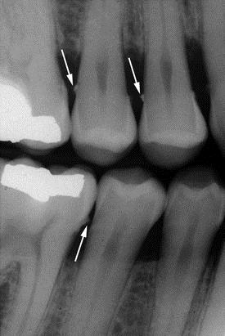

Slide 16
SUPRAGINGIVAL CALCULUS | SUBGINGIVAL CALCULUS
1. It is located coronal to gingival margin | Located below the crest of marginal gingiva.
2. It is visible in the oral cavity | Not visible on routine clinical examination. May be found by tactile exploration, radiographs, jet air blowing .
3. Color - White or whitish yellow | Dark brown or greenish black
4. Consistency - hard clay like | Hard or flint like
5.Easily detached from tooth surface. | Dense and is firmly attached to tooth surface
6.Also called salivary calculus | Serumal calculus
7.Main mineral source - saliva. | Main mineral source – Gingival crevicular fluid.

Slide 17
COMPOSITION
Inorganic: 70-90% of dry weight
  Calcium 39%
  Phosphorus 19%
  Carbon dioxide 1.9%
  Magnesium 0.8%
  Fluoride 0.003 –.04%
  Traces of .....Sodium, Zinc, Strontium, Copper, Bromine, Manganese, Fluorine, Aluminium, Silicon, Tungsten, Gold, Iron.

Slide 18
At least two thirds of the inorganic component is crystalline in structure....
Hydroxyapatite 58%
ß-tricalcium phosphate 21%
Octacalcium phosphate 12%
Brushite 9%

Slide 19
Organic components
mixture of protein–polysaccharide complexes, desquamated epithelial cells, leukocytes, and various types of micro–organisms.

Slide 20
Organic
Carbohydrate
1.9% to 9.1%
galactose, glucose, rhamnose, mannose, glucuronic acid, galactosamine
salivary glycoprotein
5.9% to 8.2%
Lipids
0.2%
neutral fats, free fatty acids, cholesterol, cholesterol esters, and phospholipids
sometimes arabinose, galacturonic acid, and glucosamine

Slide 21
Subgingival/supragingival components:
Higher calcium :phosphate ratio
Sodium content increases with the depth of periodontal pockets.
Salivary proteins not found subgingivally

Slide 22
SAME
Hydroxyapatite
MORE
Magnesium whitlockite
LESS
Octacalcium phosphate
LESS
Brushite

Slide 23
ATTACHMENT TO THE TOOTH SURFACE…..4 models
Attachment by means of an organic pellicle on enamel
Mechanical locking into surface irregularities, such as resorption lacunae
Close adaptation of calculus undersurface depressions to the gently sloping mounds of the unaltered cementum surface
Penetration of calculus bacteria into cementum……calculocementum

Slide 24
FORMATION
Soft plaque is hardened by mineralization
between 1st and 14th days of plaque formation.
Calcification
occur as soon as 4-8 hrs.
Mineralization:
50% in 2 days and
60% to 90% in 12 days

Slide 25
The initiation of calcification and the rate of calculus accumulation vary from person to person for different teeth and at different times of same person.......
SLIGHT
MODERATE
HEAVY

Slide 26
The average daily increment in calculus formers is from 0.10% to 0.15% of dry weight.
Calculus formation continues until it reaches a maximum, after which it may be reduced in amount.
The time required to reach the maximal level has been reported as 10 weeks and 6 months.

Slide 27
The decline from maximal calculus accumulation, referred to as reversal phenomenon, may be explained by the vulnerability of bulky calculus to mechanical wear from food and from the cheeks, lips, and tongue.

Slide 28
SUMMARY
Calculus can also occur readily in germ free animals. Calculocementum is the calculus embedded deeply in the cementum and which appears morphologically similar to cementum.
Calculus is the most prominent plaque retentive
factor and is a secondary etiologic factor for
periodontitis.

Slide 29
REFERENCE
Newman MG, Takei HH, Klokkevold PR, Carranza FA. Carranza’s clinical periodontology, 10th ed. Saunders Elsevier; 2007.
Lindhe J, Lang NP and Karring T. Clinical Periodontology and Implant Dentistry. 6th ed. Oxford (UK): Blackwell Publishing Ltd.; 2015.
Newman MG, Takei HH, Klokkevold PR, Carranza FA. Carranza’s clinical periodontology, 13th ed. Saunders Elsevier; 2018.

Slide 30
THANK YOU

